Slide 1




Adversarial Profiles: Detecting Out-Distribution & Adversarial Samples in Pre-trained CNNs
Arezoo Rajabi, Rakesh B. Bobba

Slide 2
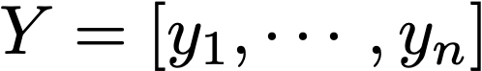
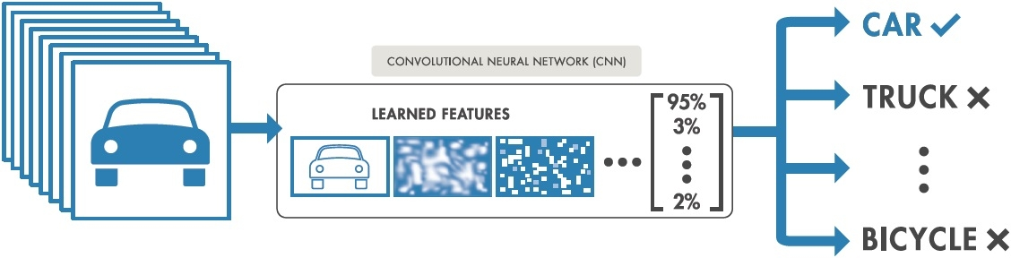

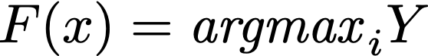
Convolutional Neural Networks(CNNS)
High accuracy on large-scale and complex image datasets
Less than 8% 5-top error on ImageNet with more than 10M images and 1000 classes
Vulnerable to adversarial and out-distribution examples

Slide 3

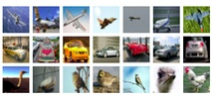
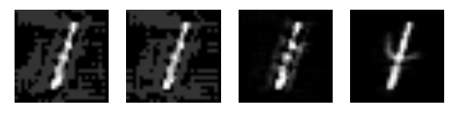
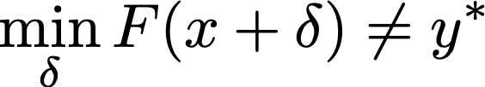
Sample Categories
In-distribution samples: Samples that belong to the same distribution as training samples
In-distribution (MNIST)
Out-distribution samples: Samples not from the same distribution (concept) as training samples
Out-distribution
(CIFAR)
Adversarial samples: Very carefully crafted in-distribution samples to fool CNNs
Adversarial Examples
label=3
label=7
label=9
label=4

Slide 4



Some Recent Related Work
 | Does not need Adv. Dataset | Does not need Retraining Network | Detects Out-Distribution | Detects Adversarial Examples
Madry et al.[ICLR 2018]
Distilation Network[S&P2016]
Feature Squeezing[NDSS2017]
Rajabi et al.[DSML2018]
FingerPrinting[arxiv2018]
Robustifying CNNs: Aim to classify adversarial examples correctly but they provide No solution for out-distribution examples
Detection and Rejection: Learn on benign and adversarial/out-distribution samples to detect and reject them.
How to make pre-trained convolutional neural networks robust against both adversarial and out-distribution examples?
Notes:
These works just focused only on adv examples detection and rejection but we considered both adv. Examples and out-distribution samples

Slide 5
Our Contribution
We introduce the notion of Adversarial Profiles to:
Detect out-distribution samples
Detect black-box adversarial examples
Without needing a large set of adversarial examples (most previous defenses depend on access to diverse set of adversarial examples)
Without re-training existing networks
With low additional computational overhead

Slide 6
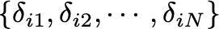



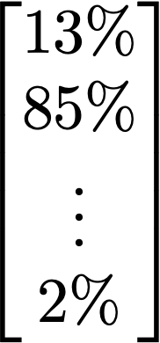
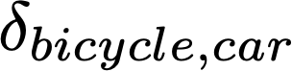


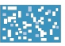
Adversarial Profile
A set of targeted universal perturbations ( ) for each class that satisfy following properties:
Intra-class Transferability: The profile of class of i should lead any sample from this class to be misclassified to target class
(B) Inter-class Transferability: The profile of class of i should not lead any sample from other classes to be misclassified to target class
CAR
TRUCK
Notes:
This slide is not clear. Make clear that the last equations are also part of the “if:condition”

Slide 7

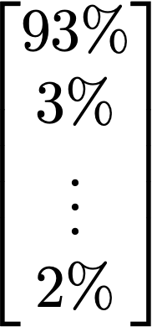

Using Adversarial Profiles for Detection
Adversarial Examples: Adversarial samples have weakened features of original class and magnified small fraction of target class’s features
Out Distribution Samples: Do not have any class features
Adversarial profiles add target class features ⇒
All adversarial profiles should lead these samples to be classified to targeted classes
Therefore, adversarial profile should not work well
CAR
TRUCK
Notes:
This slide is not clear. Make clear that the last equations are also part of the “if:condition”

Slide 8

Detection Approach
Classified to Class i
Apply this class’s adversarial profile
Does this adversarial profile work well?
No
YES
Potential Adversarial Example
Clean or Out-distribution

Slide 9
Detection Approach (Cont.)
Did this class’s adversarial profile work well?
No
Yes
Apply K random adversarial profiles (≠ i)
Apply K random adversarial profiles (≠ i)
False
Did random profiles work?
True
Out-Distribution Sample
Adversarial Example
Clean Data
Clean Data

Slide 10
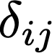
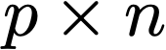
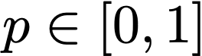
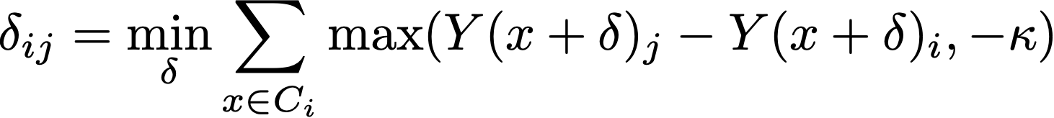
How to Learn Adversarial Profiles
We extended CW [S&P2017] attack to learn targeted universal perturbations for each class:
Take n samples from class i to learn
Stop learning if can fool of samples ( )

Slide 11
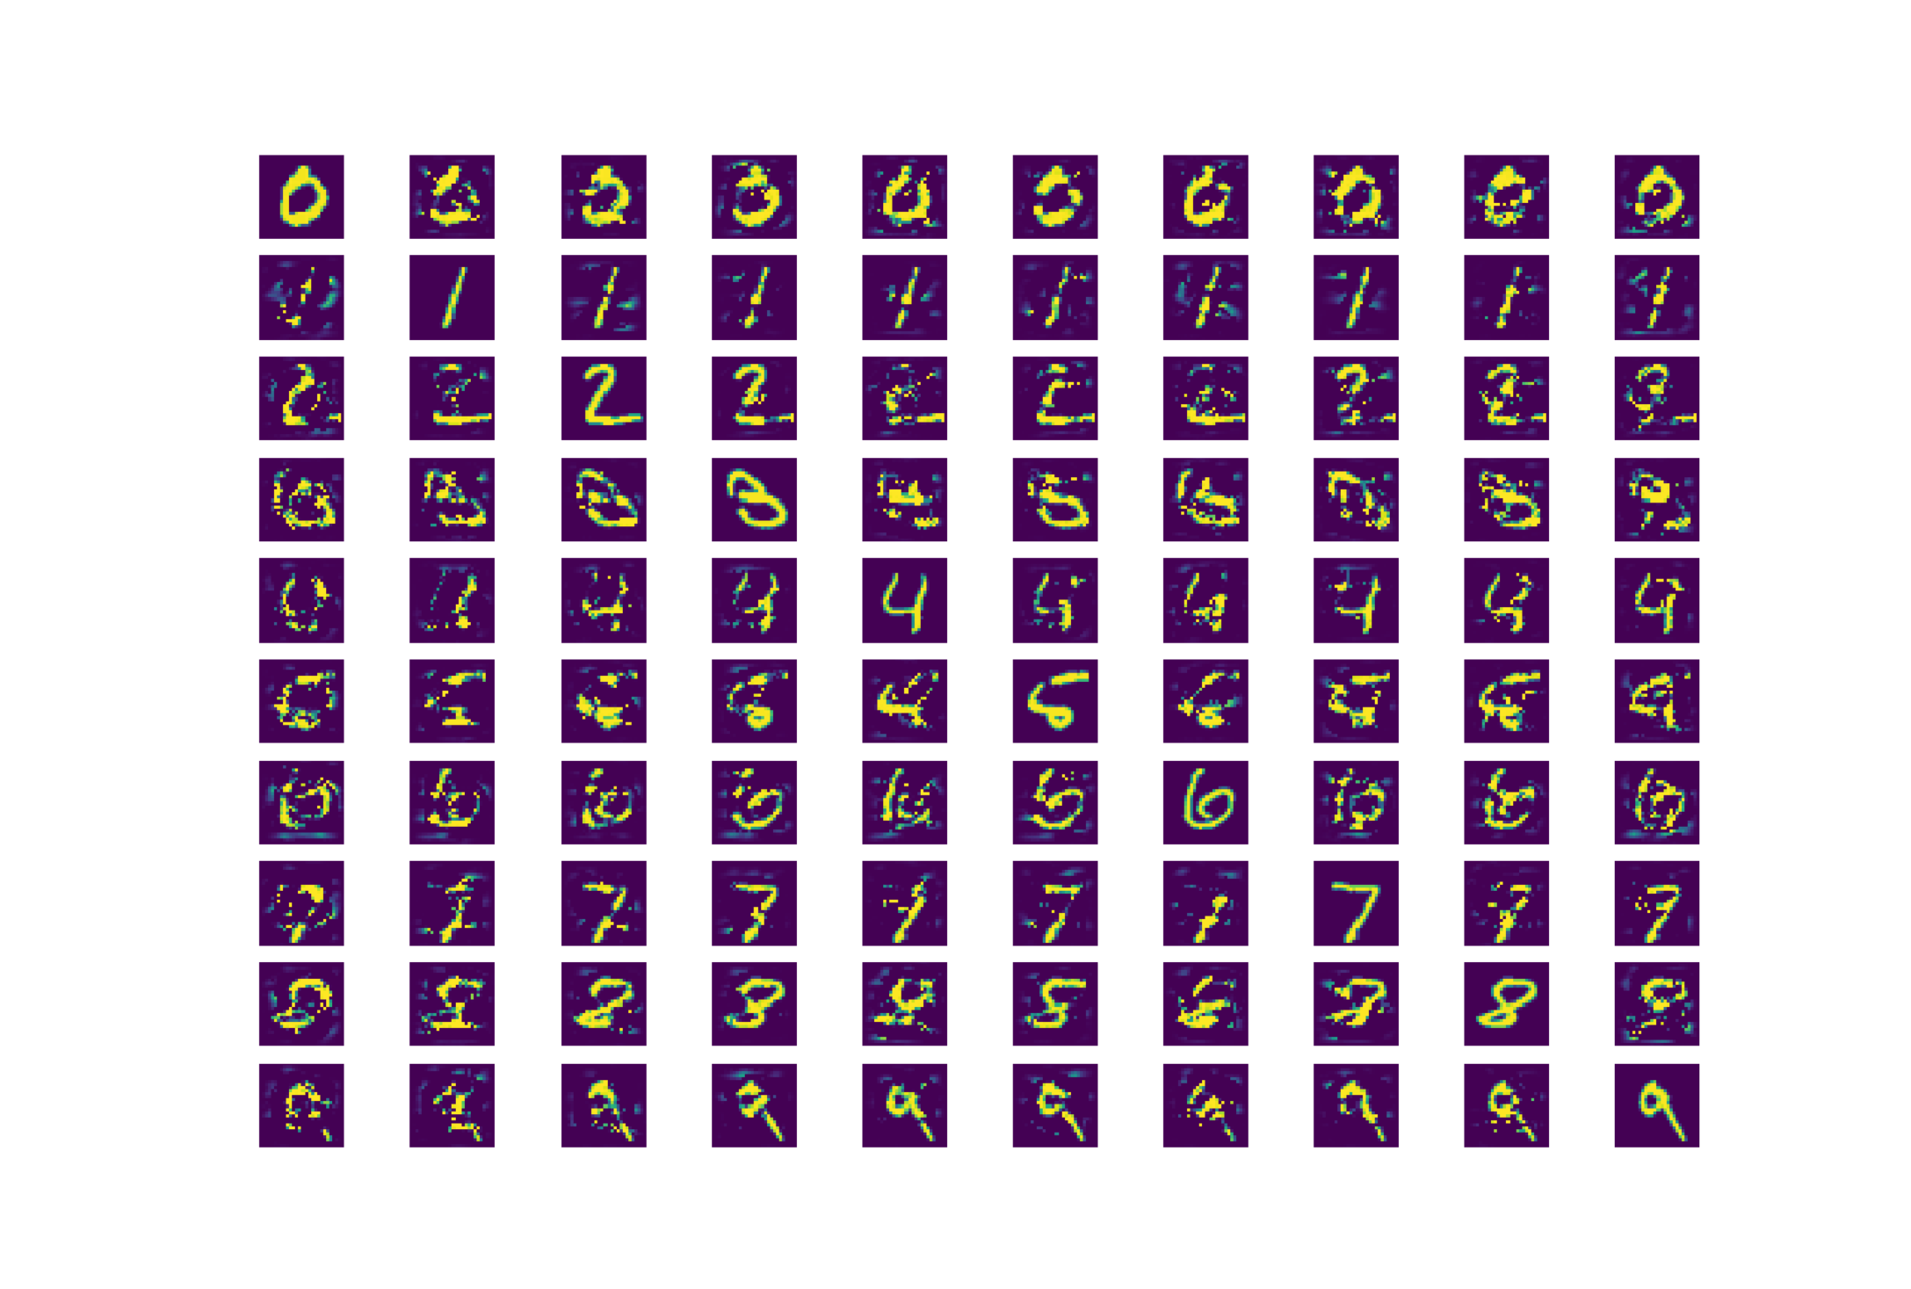
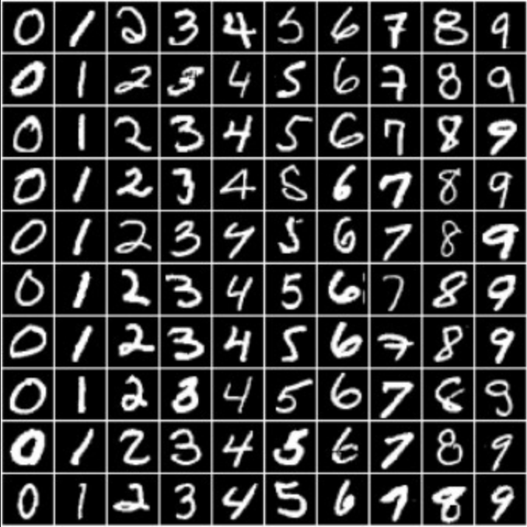
Evaluating Adversarial Profiles for MNIST Dataset
Target Class
We need to evaluate adversarial profiles
MNIST Dataset: Small images of handwriting digit numbers {0,1,2,...,9}
50000 images for training
10000 images for test
0
1
2
3
4
5
6
7
8
9
0
1
2
3
4
Source Class
5
6
7
8
9

Slide 12
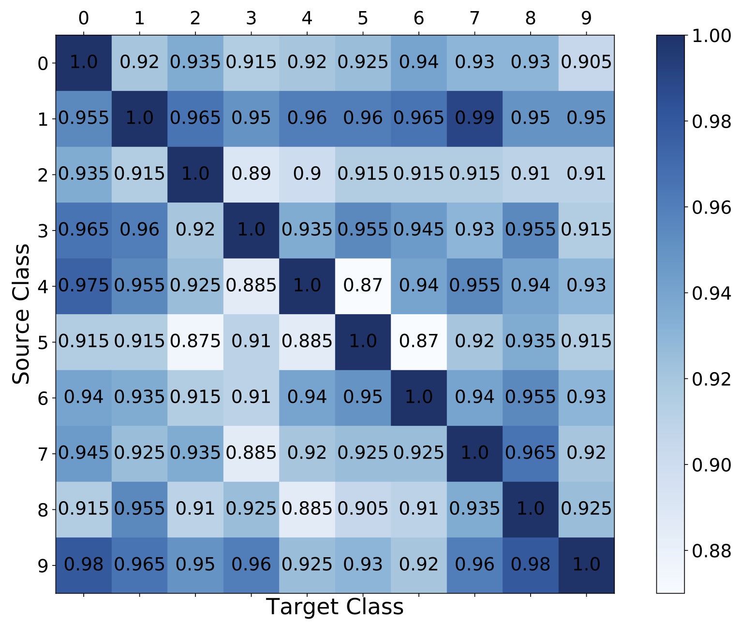
Intra-Class Transferability
Do adversarial profiles work well on source class’s samples
Use source class samples to estimate intra-class transferability

Slide 13
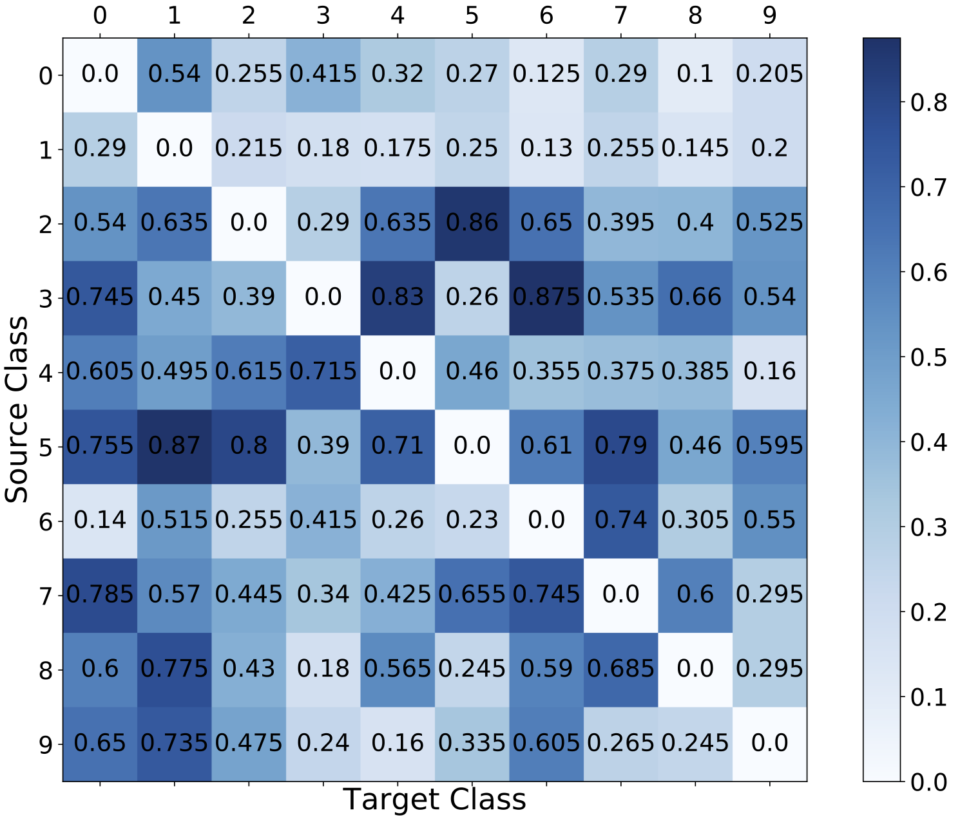
Inter-Class Transferability
Do adversarial profiles work well on non-source class samples?
Use non-source class samples to estimate inter-class transferability

Slide 14
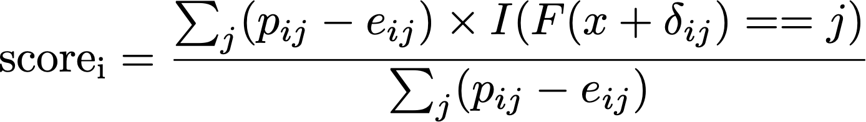
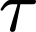
What does “Works Well” mean?
Apply adversarial profile of class i
Use a weighted score to measure how well a profile works
Does this adversarial profile work well?
No
YES
Use a threshold ( ) to decide whether the profile worked well
To tune the threshold, apply class i adversarial profile to samples form both class i and other classes.

Slide 15
Results
Input |  | Detection Rate
 | SVHN | 97%
 | ImageNet | 92%
 | Cifar100 | 92%
 | LSUN | 97%
 | FGS | 63%
 | T-FGS | 65%
 | Deep Fool | 59%
 | Iterative FGS | 64%
False Positive Rate= 8.8%
Out-Distribution Dataset
Adversarial Attacks

Slide 16
Future Work & Conclusion
Improving our objective function to generate adversarial profiles with higher intra-class and lower inter-class transferability as well as lower FPR
Evaluating our proposed method on larger datasets (e.g., CIFAR) and white-box attacks
Removing threshold by using small encoder/decoder
Conclusion:
We proposed a method for out-distribution and adversarial samples detection for pre-trained networks
We did not utilize any out-distribution or large set of adversarial examples to learn adversarial profile or tune the threshold
We can learn adversarial profile off-line; low online computational overhead

Slide 17
References
[ NDSS2017] Xu, W., Evans, D., & Qi, Y. (2018). Feature squeezing: Detecting adversarial examples in deep neural networks. Network and Distributed System Security Symposium.
[ S&P2016] Papernot, N., McDaniel, P., Wu, X., Jha, S., & Swami, A. (2016, May). Distillation as a defense to adversarial perturbations against deep neural networks. In Security and Privacy (SP), 2016 IEEE Symposium on (pp. 582-597).
[ICLR2018] Madry, A., Makelov, A., Schmidt, L., Tsipras, D., & Vladu, A. (2018). Towards deep learning models resistant to adversarial attacks. International Conference on Learning Representations(ICLR).
[S&P2017] Carlini, N., & Wagner, D. (2017, May). Towards evaluating the robustness of neural networks. In Security and Privacy (SP), 2017 IEEE Symposium on (pp. 39-57). IEEE.
[arxive2018] Dathathri, S., Zheng, S., Murray, R. M., & Yue, Y. (2018). Detecting Adversarial Examples via Neural Fingerprinting. arXiv preprint arXiv:1803.03870.

Slide 18

Thank You
rajabia@oregonstate.edu
rakesh.bobba@oregonstate.edu

Slide 19
Adversarial Profiles Evaluation
High Intra-Class Transferability
Low Inter-Class Transferability
Weighted Score

